Slide 1
Code Design
Error Handling
It 426

Slide 2

Use unchecked exceptions
Checked exceptions have proven to be thorn in the side of developers
You can write robust programs without checked exceptions
C#, C++, Ruby, Python...
Check exceptions violate the open-closed principle!

Slide 3
Open-closed principle violation
2. Add throws clause,
rebuild, redeploy
We are catching
any exceptions
here
new Customer()
new Account()
saveToDb()
register Account()
webAccess()
save Credential()
save Customer()
save Account()
enable Account()
1. Add new checked exception
(is this possible without breaking the OCP as well?)

Slide 4
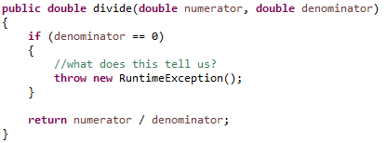
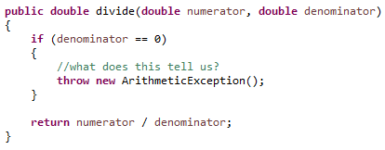
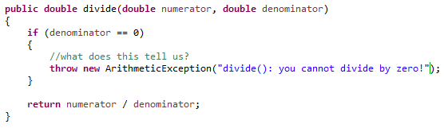
Provide context with exceptions
When an error is thrown you should be able to identify
Location where it happened?
Handled by the IDE
Stack trace
Handled by the IDE
What happened?
Name of the exception class
Message sent to the exception object

Slide 5

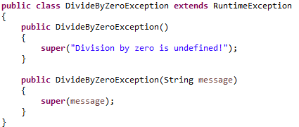
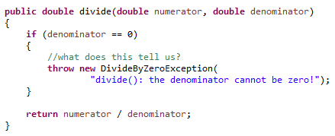
Provide context with exceptions
Time spent writing good error messages pay off in the long run
When you revisit your code
When you debug your code
When in doubt, write your own exception classes

Slide 6
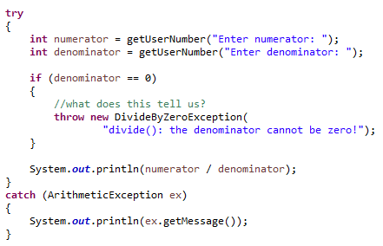
Don’t use exceptions for regular flow control
Exceptions should not be used for normal situations
How would we know when something exceptional occurs?
Exceptions should not be used just to alter regular flow control
Do we really need this
try-catch?

Slide 7
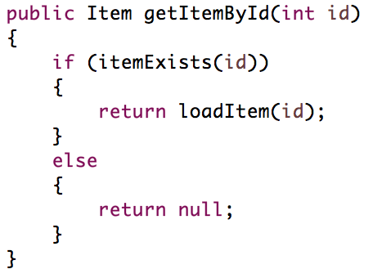
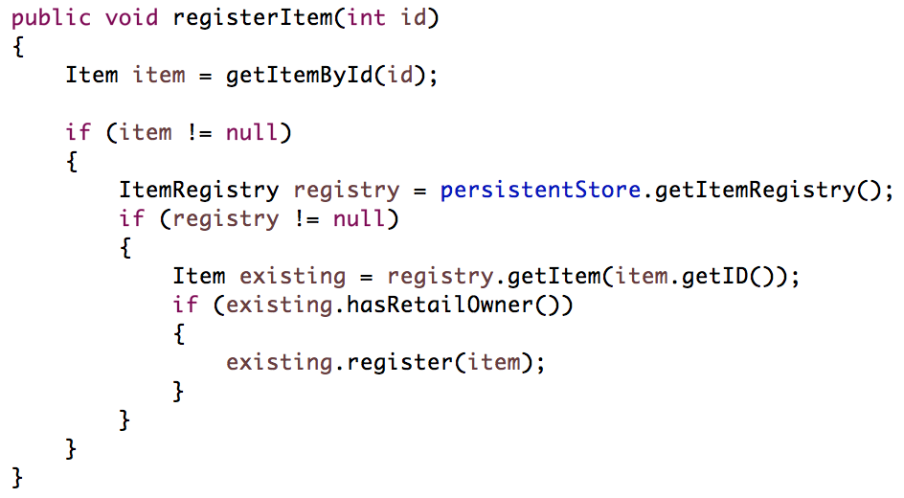
Don’t return null
Code bases can be littered with checks for null values

Slide 8
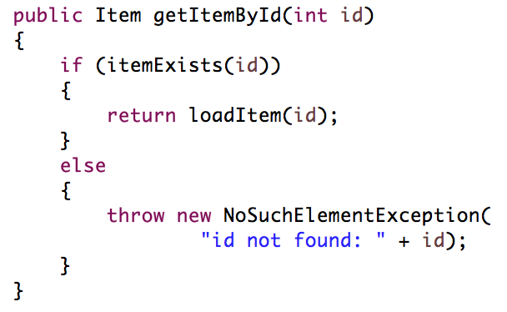
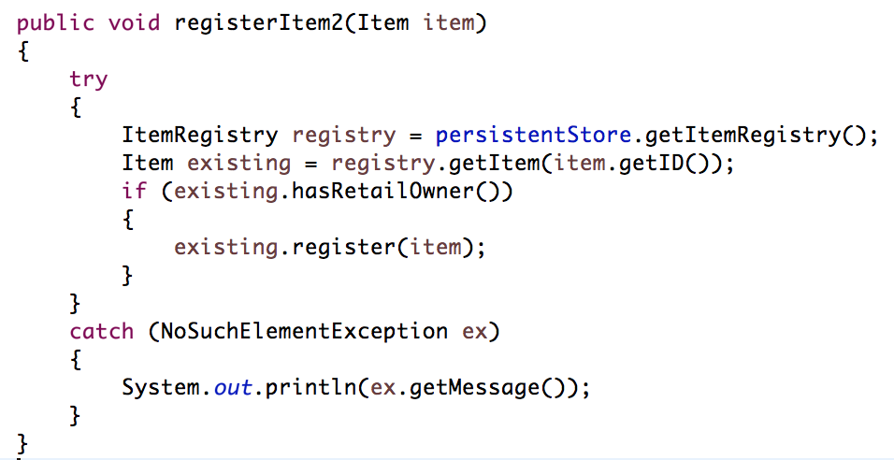
Don’t return null
Alternative - throw exceptions
This will also create clutter in your code

Slide 9
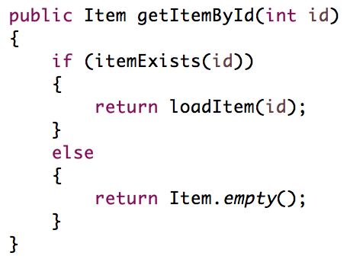
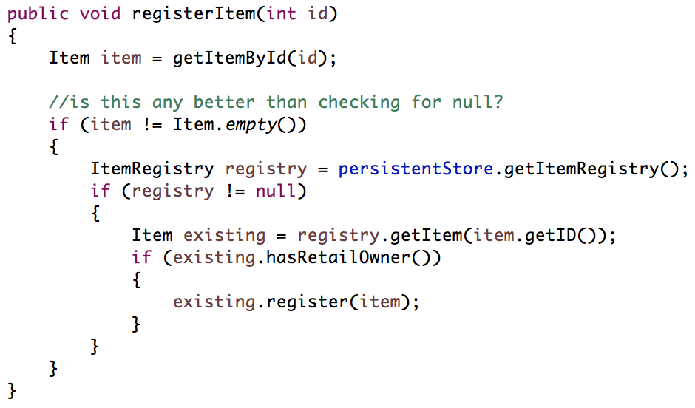
Don’t return null
Alternative - use default objects

Slide 10
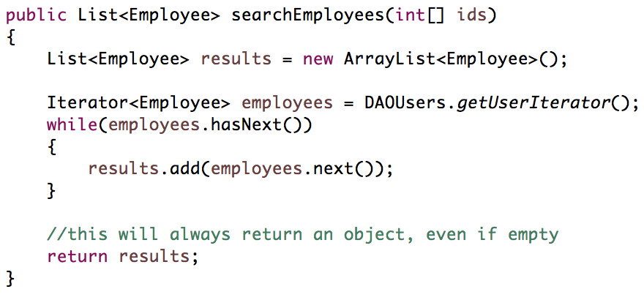
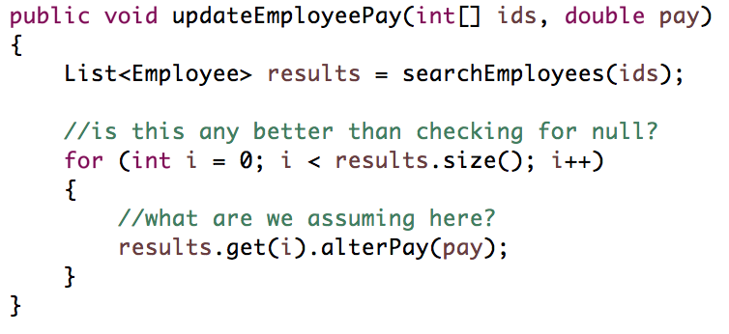
Don’t return null
Alternative - use default objects

Slide 11

Don’t return null
Alternative - minimize the use of return null values
We can’t avoid the fact that we need to deal with missing results sometimes
We can’t avoid this anymore than mathematicians can ignore the number zero
Prefer default objects first, if intuitive
Otherwise use null values

Slide 12

D0n’t pass null as function arguments
How do we then deal with optional arguments?
public void drawShape(shape, color,
border, filled);
Write a method for each combination of inputs?
drawBorderedShape();
drawFilledShape();
drawShape();
drawBorderedFilledShape();

Slide 13

D0n’t pass null as function arguments
Avoid passing null to functions, when possible
Is the following function call readable?
drawShape(myRect, myColor, null, null, 10, 10);
A better alternative, using default objects
drawShape(myRect, myColor, Border.NONE, Fill.NONE, 10, 10);

Slide 14
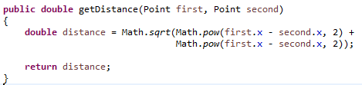
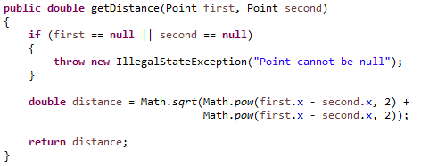
D0n’t pass null as function arguments
Is there a good or easy way to respond to unexpected null arguments?

Slide 15
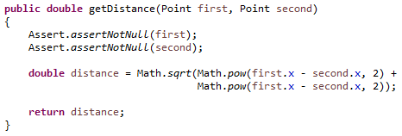
D0n’t pass null as function arguments
These types of errors should cause your program to terminate
They should not make it into production level code
Use Assertion frameworks that verify inputs/outputs during a testing phase
Assertions are then removed when a program is deployed (automatically by the compiler)

Slide 16
Sources
Martin, Robert C. Clean Code. New Jersey: Pearson Education Inc, 2009.

Slide 17
Code Design
Error Handling
It 426

